Slide 1
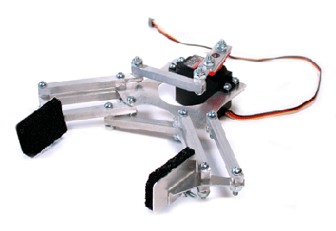
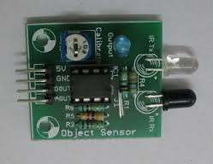
IR ROBOT
AUTOMATED GRIPPER MECHANISM
TEAM:
Pranav Sankhe
Anant Jain
Ashwini Kumar Singh

Slide 2
Outline of the 1st prototype
1.We are attempting to build a bot which automatically measures the dimensions of the object and accordingly the gripper will grip the object.
2.The dimensions of the objects is measured by the IR sensor plate .
3.The gripper mechanism used, employees 3 motors to control its motion
4.Also if the object is out of scope of the gripper we have a mechanism via which the gripper orients itself and comes in the vicinity of the object. The presence of the object is sensed by the

Slide 3
IR sensors located at the extremes of the IR sensor plates .
5.The movement of the bot is controlled by a simple RC car which operates on differential steering.
[we also have uploaded extra pdfs and ppt’s ,videos and pics in this presentation itself to understand the working of bot more efficiently]

Slide 4
Following are the components used in
our bot:
Arduino UNO
IR sensors
IC L293D
IC 7805
4 200RPM Motors, 3 low RPM Motors
Acrylic sheets
Gears
Connecting wires
Bluetooth module
attiny IC (microcontroller)
11.male and female berg pins
12.female jumpers
13.PCB

Slide 5
14.Gears
15.Nuts, bolts ,washers , screws

Slide 6

ROUGH MECHANISM OF GRIPPER

Slide 7
For more informations about grippers refer he PDF given below:
More about grippers....
(a PDF)

Slide 8
Materials used in gripper:
Acrylic (used since was available readily. Can use metal
or wood also.)
Gears
Motors( a low RPM motor)
Screws
Nut, bolts, washers
Instruments used :
Saw
Filer
Vice
Marker
Drilling machine
screwdriver

Slide 9
ACTUAL GRIPPER MADE BY US :
TAKE A PIC AND UPLOAD HERE

Slide 10
The bot’s motion is controlled by a simple RC car
So now lets see how can we build an RC car..........
First comes the mechanical part:
1:In our RC car we have used an acrylic chassis .
2:We have used 4 200 RPM motors to
ensure good torque so that we can climb up inclines easily.
3:The steering mechanism used is differential since it is the most
easiest mechanism and we can make very sharp turns with it.
4:The battery used is lead acid battery .

Slide 11
This PDF has all information about the
mechanical part of an RC car

Slide 12
Now comes the electric part of our RC car which will drive the car
The components used are:
1: IC L293D
2: IC 7805
3: heat sink
4: soldering wire
5: male and female berg pins
6: female jumpers
7: PCB
8:bluetooth module
9:attiny ( a microcontroller)
Instruments used :
1:soldering gun
We have used bluetooth module too control our bot’s motion wirelessly.
There’s an anroid app for this

Slide 13
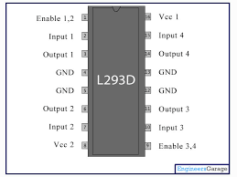
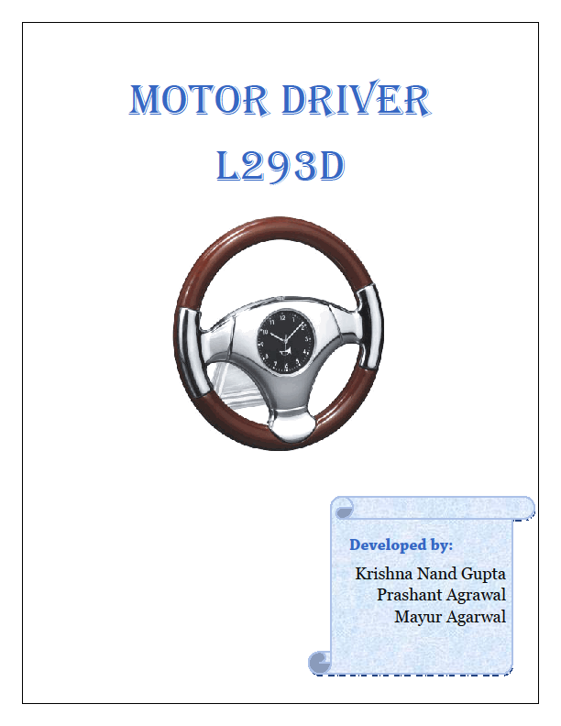
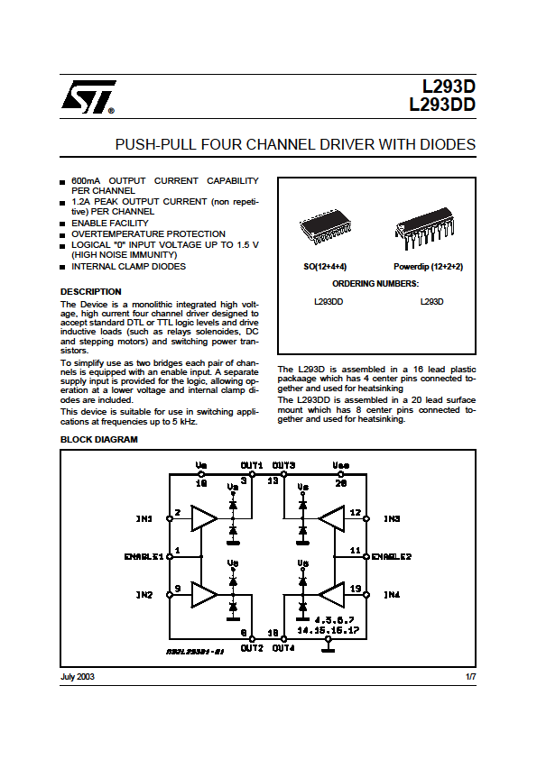
Lets first learn a bit about some IC’s we are gonna used
PDF FOR IC L293D:
IC L293D
We are using IC L293D to give outputs to the gripper motors
and the motors used to move the bot.

Slide 14
Brief description of pins of L293D
IC L293D is a dual H bridge motor driver IC. Motor drivers in general are
current amplifiers since they take in low current signal and in output send a
higher current output.
The motors can be controlled by input logic pins at pins 2,7,10,15.
The logic input 00 or 11 will stop the motor and logic inputs 10 or 01 will
rotate the motor in anticlockwise or clockwise direction respectively.
Enable pins 1 and 9 should be high for motors to start operating. When
enable input is high the corresponding driver circuit gets enabled. Due to it
the outputs work in phase with inputs. When enable inputs are low the driver
is disabled ,the outputs are off and in high impedance state.
Pin 8 is supplied voltage of 12 volts which is applied to the motor windings.
Pin 16 is the logic supply voltage which is required to power the internal
components of the IC.

Slide 15
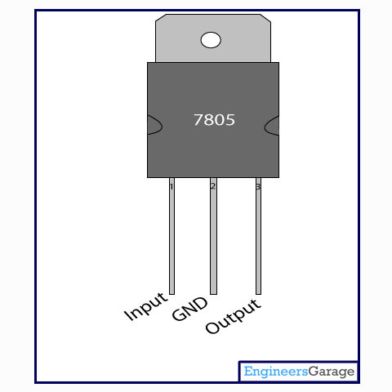
IC 7805
This IC is used to convert 12 volts to 5 volts . Its used here since the electronic circuits operates on 5 volts.

Slide 16
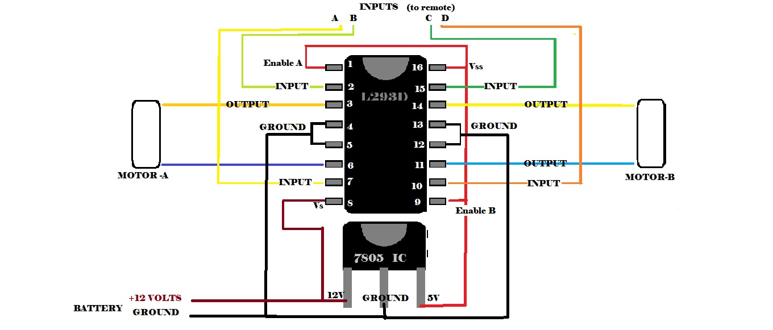
Circuit which controls the movement of bot.

Slide 17
This are the resources which you can refer to design the electrical part of your RC car.
Circuit of RC car
Anroid app
Bluetooth module

Slide 18
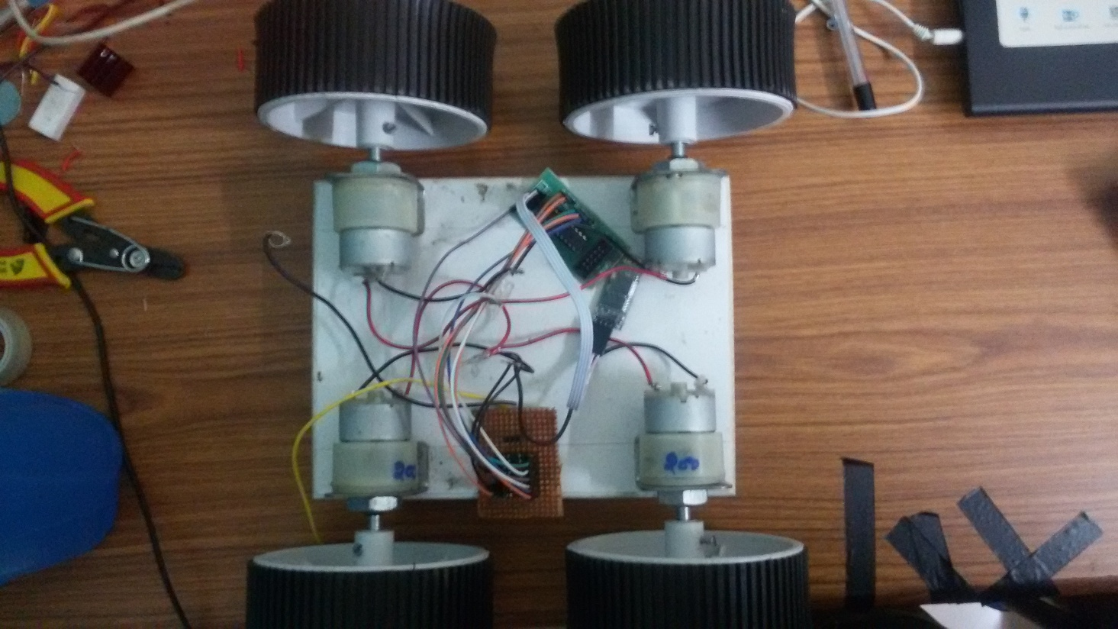

Slide 19
Now we are done with the motion of our bot as a whole now
we will consider how we will control the motion of our
gripper .
So in further slides we will focus on the connections of our
circuits used In grippers.
The components used in circuits of gripper:

Slide 20
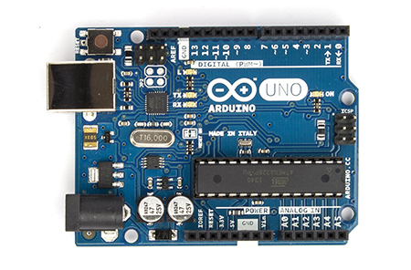
ARDUINO UNO
We have used an arduino uno to used to program
our bot’s gripper. All the motions of gripper are
controlled by arduino.

Slide 21
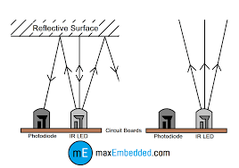
IR SENSOR
We have used IR sensors for detecting the presence of the
object and measuring its dimensions.
In IR Photodiode sensor the IR emitter LED is forward biased and the IE
(detector) is reverse biased . When the photodiode
detects IR radiation, the output voltage is low and vice versa.
Here, when IR sensors detects the objects the arduino counts how much sensors are getting
low and accordingly then it calculates the length of the object.
Upload circuit diagram of IR sensor

Slide 22
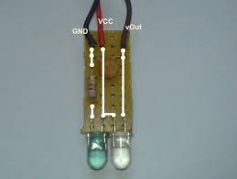
IR SENSORS
When the IR sensors in the extremes detect the object, it tells to the arduino that the object is out of domain of the gripper and then accordingly arduino tells the motor (which controls the sideways motion of gripper) to operate and thus the gripper is brought in the vicinity of the object.
Upload a pdf here of IR sensors

Slide 23
1:All the IR sensors share a common ground .
2:Each one receives a common Vcc of +5 volts.
3:The resistance between +terminal of LED an Vcc is 470 ohms for all sensors.
4:the resistance between –terminal of photodiode and Vcc is either 68 Kohms
or100 Kohms.
(Given below is the spreadsheet which has observations of the range of output
Voltages for various resistances(68K &100K))
CONNECTIONS OF IR SENSORS
Upload a circuit diagram
Here of a IR sensor

Slide 24
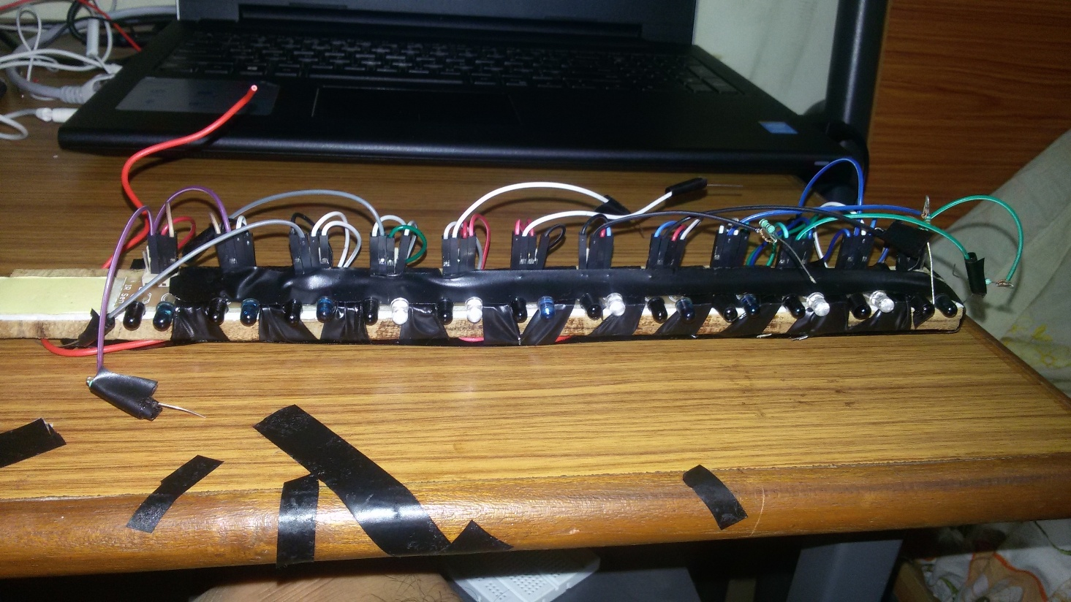
IR SENSOR PLATE

Slide 25
Draw a circuit diagram showing connections of IR
sensor plate

Slide 26
PWM 1, ,2, ,3, 4, ,5, ,6, will direct the gripper to the object which we have
to grip A0, A1 ,A2, A3, A4, A5 are to measure the length of the object
and accordingly will instruct the gripper motor to operate and make a
specific angle which will correspond to the dimensions of object.
NOTE:
(just PWM 1 and 6 will do the job of bringing the gripper in the vicinity of
the object & we can increase the accuracy and range of our
measurement calculations by operating 10 IR sensors instead of 6.)
IR SENSOR PLATE
PMW (1 2 3)
3
A0
A1
A2
A3
A4
A5
PMW( 4 5 6 )

Slide 27
CONNECTIONS OF IR SENSORS TO ARDUINO:
1: pins 3,5,6,9,10,11are connected to the3 IR sensors on each extremes.
2: pin A0,A1,A2,A3,A4,A5 are connected to 6 IR sensors located in
central portion of the sensor plate.
Draw a circuit diagram

Slide 28
CONNECTIONS OF ARDUINO TO L293D
(THIS L293D IS CONTOLLING SIDEWAYS MOTOR)
Outputs to L293D are pin : 2, 4 , 7 , 8 (arduino digital outputs)
Pin 7 of arduino is connected to Pin 2 of L293D
Pin 8 of arduino is connected to Pin 7 of L293D
This pins (7 and 8 ) are controlling the rotation of gripper about itself . i.e.it is used for sideways movement of gripper.
When the left PMW pins give a signal the these outputs(pins 7 and 8) get high and via IC L293D gives output to motor instructing it to move the gripper in right direction . Vice versa when right PWM pins give signal .
Thus we are orienting our gripper according to our object in order to measure it

Slide 29
Draw a circuit diagram of connections explained in previous slide

Slide 30
CONNECTIONS TO L293D (FOR GRIPPER MOTOR)

Slide 31
Here comes the programming part:
Arduino code:

